Slide 1
奇异值分解
主讲人：赵维锐
单位：武汉理工大学

Slide 2


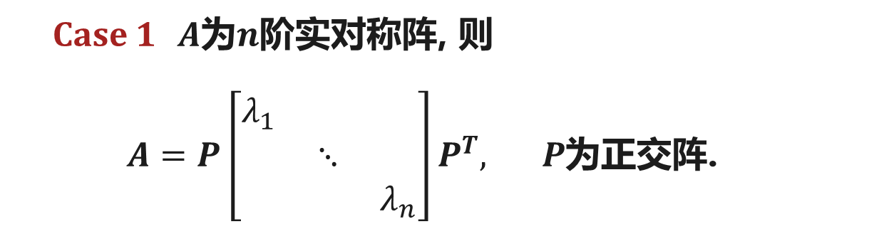
奇异值分解
设$A$为$m×n$矩阵, 则
$A=P\left[\begin{matrix}E_{r} & O \\ O & O\end{matrix}\right]Q, P,Q$可逆
问题
矩阵$P,Q$能否为酉矩阵或正交阵?
Case 1 $A$为$n$阶实对称阵, 则
$A=P\left[\begin{matrix}λ_{1} & & \\ & ⋱ & \\ & & λ_{n}\end{matrix}\right]P^{T}, P$为正交阵.
Case 2 $A$为一般$m×n$矩阵？

Slide 3
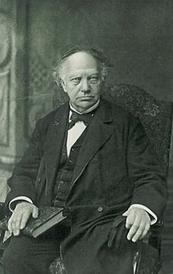
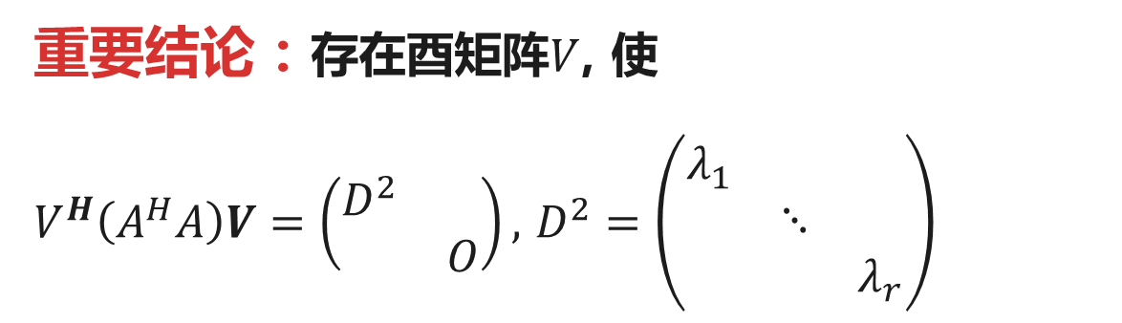
奇异值分解
$A^{H}A$的性质
C. Hermite (1822-1901, 法国)
(1) $A^{H}A$是半正定的Hermite矩阵;
(2) $A^{H}A$的特征值均非负数;
(3) $rank\left(A^{H}A\right)=rank(A)$.
重要结论：存在酉矩阵$V$, 使
$V^{H}\left(A^{H}A\right)V=\left(\begin{matrix}D^{2} & \\ & O\end{matrix}\right),$ $D^{2}=\left(\begin{matrix}λ_{1} & & \\ & ⋱ & \\ & & λ_{r}\end{matrix}\right)$

Slide 4
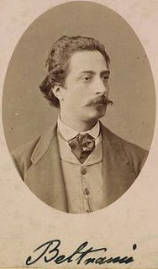
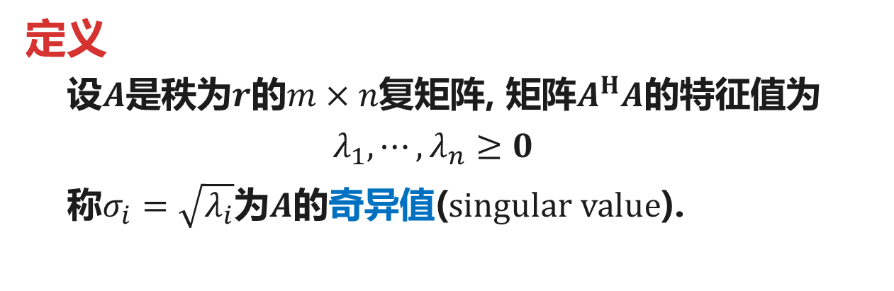
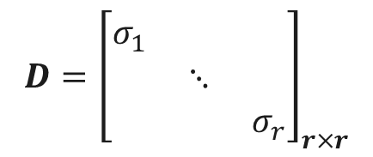
奇异值分解
定义
设$A$是秩为$r$的$m×n$复矩阵, 矩阵$A^{H}A$的特征值为
$$λ_{1},⋯,λ_{n}≥0$$
称$σ_{i}=\sqrt{λ_{i}}$为$A$的奇异值(singular value).
E. Beltrami (1835-1900, 意大利)
对奇异值进行排序
$$σ_{1}≥σ_{2}≥⋯≥σ_{r}>0=σ_{r+1 }=⋯=σ_{n}$$
令
$$D={\left[\begin{matrix}σ_{1} & & \\ & ⋱ & \\ & & σ_{r}\end{matrix}\right]}_{r×r}$$

Slide 5
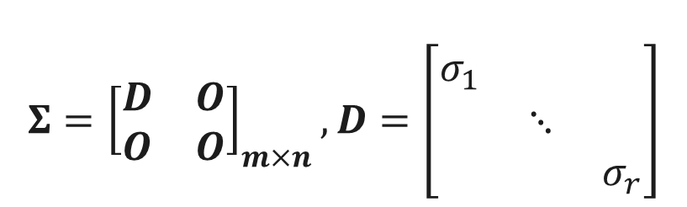

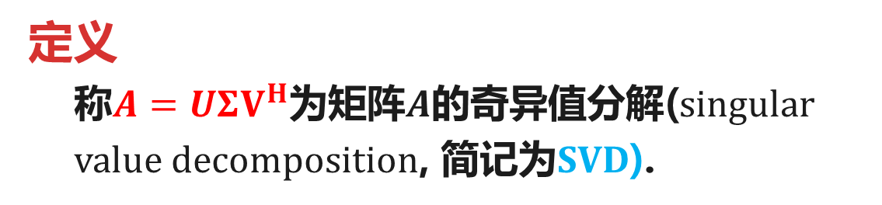
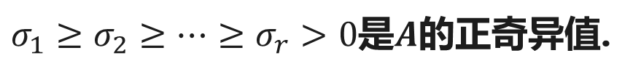
奇异值分解
定理(Autonne-Eckart-Young, 1939)
设$A$是秩为$r$的$m×n$复矩阵, 则存在酉矩阵$U,V$使
$$A=UΣV^{H}$$
Eckart, C. and Young, G. (1939) A Principal Axis Transformation for Non-Hermitian Matrices. Bulletin of the American Mathematical Society, 45, 118-121.
其中,
$$Σ={\left[\begin{matrix}D & O \\ O & O\end{matrix}\right]}_{m×n},D=\left[\begin{matrix}σ_{1} & & \\ & ⋱ & \\ & & σ_{r}\end{matrix}\right]$$
$σ_{1}≥σ_{2}≥⋯≥σ_{r}>0$是$A$的正奇异值.
定义
称$A=UΣV^{H}$为矩阵$A$的奇异值分解(singular value decomposition, 简记为SVD).

Slide 6
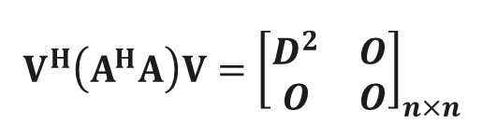
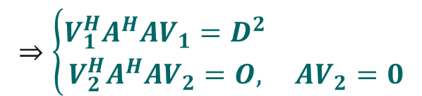
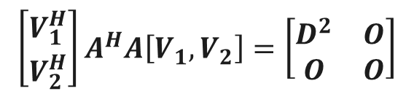
奇异值分解
证明
Step 1 $A^{H}A$对角化. 存在酉矩阵$V$使得
$$V^{H}\left(A^{H}A\right)V={\left[\begin{matrix}D^{2} & O \\ O & O\end{matrix}\right]}_{n×n}$$
令$V=\left(V_{1},V_{2}\right)$,
$V_{1}=(v_{1},⋯,v_{r})$为$A^{H}A$的正特征值所对应的特征向量.
$$\left[\begin{matrix}V_{1}^{H} \\ V_{2}^{H}\end{matrix}\right]A^{H}A\left[V_{1},V_{2}\right]=\left[\begin{matrix}D^{2} & O \\ O & O\end{matrix}\right]$$
$$⇒\left\{\begin{matrix}V_{1}^{H}A^{H}AV_{1}=D^{2} & \\ V_{2}^{H}A^{H}AV_{2}=O, & AV_{2}=0\end{matrix}\right.$$

Slide 7
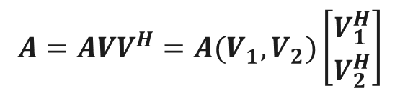

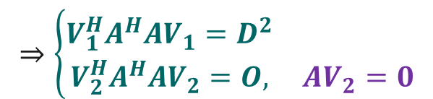



奇异值分解
证明
$$⇒\left\{\begin{matrix}V_{1}^{H}A^{H}AV_{1}=D^{2} & \\ V_{2}^{H}A^{H}AV_{2}=O, & AV_{2}=0\end{matrix}\right.$$
$$A=AVV^{H}=A(V_{1},V_{2})\left[\begin{matrix}V_{1}^{H} \\ V_{2}^{H}\end{matrix}\right]$$
$$=AV_{1}V_{1}^{H}+AV_{2}V_{2}^{H}$$
$$=AV_{1}V_{1}^{H}$$
$$=AV_{1}D^{−1}DV_{1}^{H}$$
$$=U_{1}DV_{1}^{H}$$
Step 2 取$U_{1}=AV_{1}D^{−1}$

Slide 8

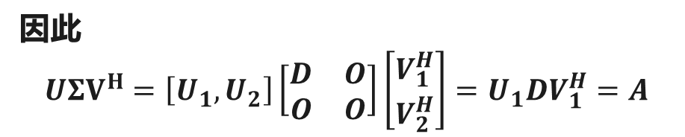
奇异值分解
证明
Step 2 取$U_{1}=AV_{1}D^{−1}$
Step 3 扩充$U_{1}=[u_{1},⋯,u_{r}]$为$ℂ^{m}$的标准正交基:
$$u_{1},⋯,u_{r},u_{r+1 },⋯,u_{m}$$
Step 4 取$U=[U_{1},U_{2}]$
因此
$$UΣV^{H}=\left[U_{1},U_{2}\right]\left[\begin{matrix}D & O \\ O & O\end{matrix}\right]\left[\begin{matrix}V_{1}^{H} \\ V_{2}^{H}\end{matrix}\right]=U_{1}DV_{1}^{H}=A$$

Slide 9


奇异值分解的步骤
Step 1 求酉矩阵$V=[V_{1},V_{2}]$使得$A^{H}A$对角化
$V_{1}=(v_{1},⋯,v_{r})$为$A^{H}A$的正特征值所对应的特征向量.
Step 2 取$U_{1}=AV_{1}D^{−1}$
Step 3 扩充$U_{1}=[u_{1},⋯,u_{r}]$为$ℂ^{m}$的标准正交基:
$$u_{1},⋯,u_{r},u_{r+1 },⋯,u_{m}$$
Step 4 取$U=[U_{1},U_{2}]$
得到
$$A=UΣV^{H}$$

Slide 10

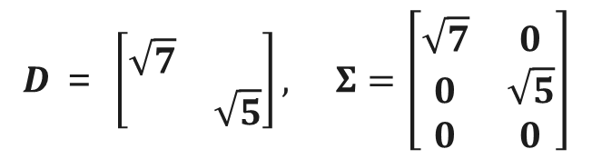
奇异值分解
例1 求$A=\left[\begin{matrix}1 & 1 \\ 1 & −2 \\ 2 & 1\end{matrix}\right]$的奇异值分解.
解 $A^{T}A=\left[\begin{matrix}6 & 1 \\ 1 & 6\end{matrix}\right]$, 根据$|λE−A^{T}A|=\left(λ−5\right)\left(λ−7\right)$得特征值
$$λ_{1}=7,λ_{2}=5$$
奇异值为$σ_{1}=\sqrt{7}$, $σ_{2}=\sqrt{5}$. 于是
$$D ＝ \left[\begin{matrix}\sqrt{7} & \\ & \sqrt{5}\end{matrix}\right], Σ=\left[\begin{matrix}\sqrt{7} & 0 \\ 0 & \sqrt{5} \\ 0 & 0\end{matrix}\right]$$

Slide 11
奇异值分解
例1 求$A=\left[\begin{matrix}1 & 1 \\ 1 & −2 \\ 2 & 1\end{matrix}\right]$的奇异值分解.
当$λ_{1}=7$时, 根据$\left(7E−A^{T}A\right)x=0$得到$p_{1}=\left[\begin{matrix}1 \\ 1\end{matrix}\right]$
当$λ_{2}=5$时, 根据$\left(5E−A^{T}A\right)x=0$得到$p_{2}=\left[\begin{matrix}1 \\ −1\end{matrix}\right]$
将$p_{1},p_{2}$正交化单位化得到$v_{1}=\frac{1}{\sqrt{2}}\left[\begin{matrix}1 \\ 1\end{matrix}\right],v_{2}= \frac{1}{\sqrt{2}}\left[\begin{matrix}1 \\ −1\end{matrix}\right]$
令$V=\frac{1}{\sqrt{2}}\left[\begin{matrix}1 & 1 \\ 1 & −1\end{matrix}\right]=V^{T}$.

Slide 12
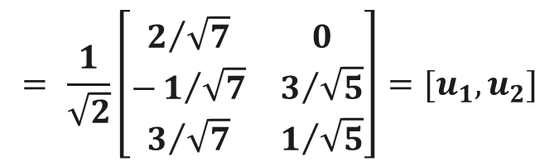

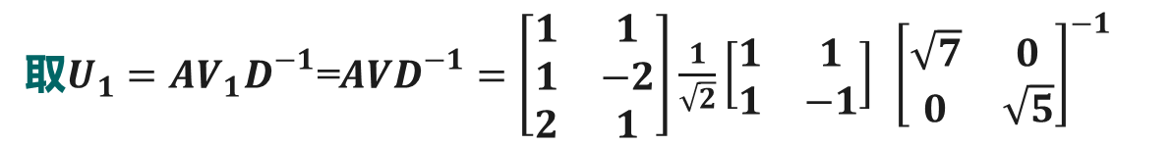
奇异值分解
例1 求$A=\left[\begin{matrix}1 & 1 \\ 1 & −2 \\ 2 & 1\end{matrix}\right]$的奇异值分解.
取$U_{1}=AV_{1}D^{−1}\text{=}AVD^{−1}=\left[\begin{matrix}1 & 1 \\ 1 & −2 \\ 2 & 1\end{matrix}\right]\frac{1}{\sqrt{2}}\left[\begin{matrix}1 & 1 \\ 1 & −1\end{matrix}\right] {\left[\begin{matrix}\sqrt{7} & 0 \\ 0 & \sqrt{5}\end{matrix}\right]}^{−1}$
$$= \frac{1}{\sqrt{2}}\left[\begin{matrix}2/{\sqrt{7}} & 0 \\ −1/{\sqrt{7}} & 3/{\sqrt{5}} \\ 3/{\sqrt{7}} & 1/{\sqrt{5}}\end{matrix}\right]=[u_{1},u_{2}]$$
解方程组$U_{1}^{T}x=0$, 得$\left[\begin{matrix}5 \\ 1 \\ \text{−}3\end{matrix}\right]$, 单位化得$u_{3}=\frac{1}{\sqrt{35}}\left[\begin{matrix}5 \\ 1 \\ \text{−}3\end{matrix}\right]$

Slide 13
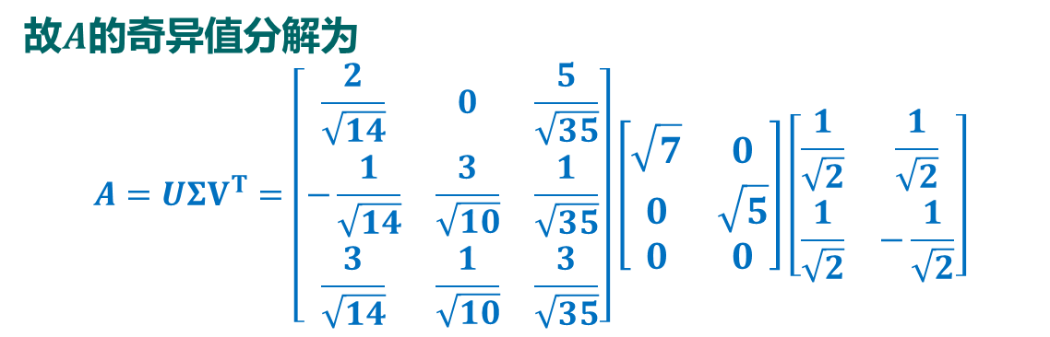
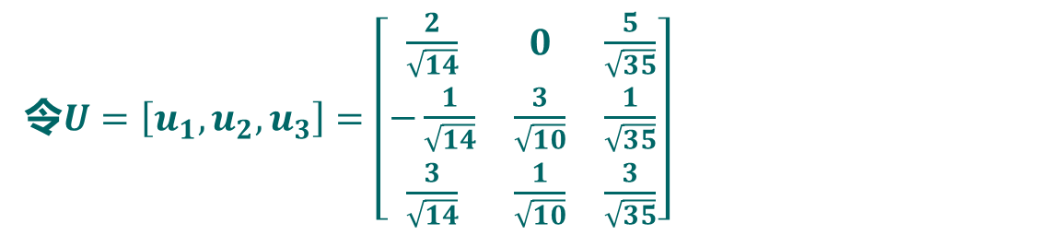
奇异值分解
例1 求$A=\left[\begin{matrix}1 & 1 \\ 1 & −2 \\ 2 & 1\end{matrix}\right]$的奇异值分解.
令$U=\left[u_{1},u_{2},u_{3}\right]=\left[\begin{matrix}\frac{2}{\sqrt{14}} & 0 & \frac{5}{\sqrt{35}} \\ −\frac{1}{\sqrt{14}} & \frac{3}{\sqrt{10}} & \frac{1}{\sqrt{35}} \\ \frac{3}{\sqrt{14}} & \frac{1}{\sqrt{10}} & \frac{3}{\sqrt{35}}\end{matrix}\right]$
故$A$的奇异值分解为
$$A=UΣV^{T}=\left[\begin{matrix}\frac{2}{\sqrt{14}} & 0 & \frac{5}{\sqrt{35}} \\ −\frac{1}{\sqrt{14}} & \frac{3}{\sqrt{10}} & \frac{1}{\sqrt{35}} \\ \frac{3}{\sqrt{14}} & \frac{1}{\sqrt{10}} & \frac{3}{\sqrt{35}}\end{matrix}\right]\left[\begin{matrix}\sqrt{7} & 0 \\ 0 & \sqrt{5} \\ 0 & 0\end{matrix}\right]\left[\begin{matrix}\frac{1}{\sqrt{2}} & \frac{1}{\sqrt{2}} \\ \frac{1}{\sqrt{2}} & −\frac{1}{\sqrt{2}}\end{matrix}\right]$$

Slide 14
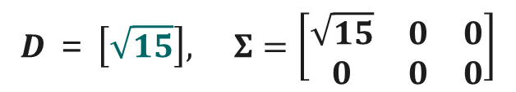
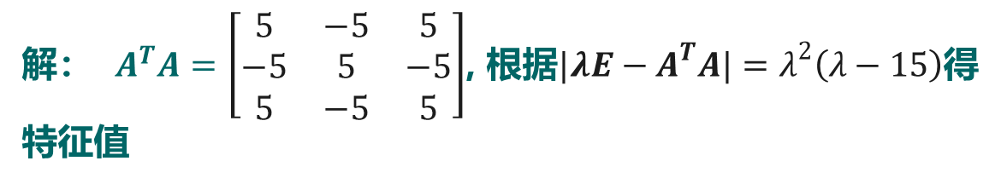
奇异值分解
例2 求$A=\left[\begin{matrix}1 & −1 & 1 \\ −2 & 2 & −2\end{matrix}\right]$的奇异值分解.
解： $A^{T}A=\left[\begin{matrix}5 & −5 & 5 \\ −5 & 5 & −5 \\ 5 & −5 & 5\end{matrix}\right]$, 根据$|λE−A^{T}A|=λ^{2}\left(λ−15\right)$得特征值
$$λ_{1}=15,λ_{2}=λ_{3}=0$$
正奇异值为$σ_{1}=\sqrt{15}$. 于是
$$D ＝ \left[\sqrt{15}\right], Σ=\left[\begin{matrix}\sqrt{15} & 0 & 0 \\ 0 & 0 & 0\end{matrix}\right]$$

Slide 15
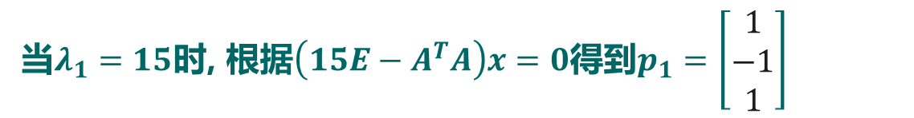
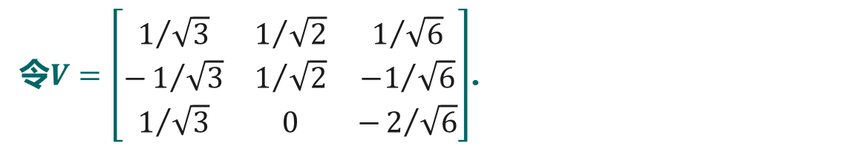
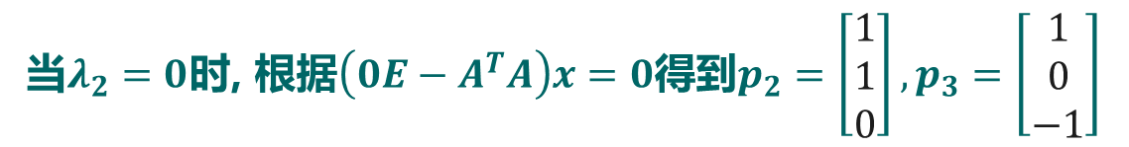
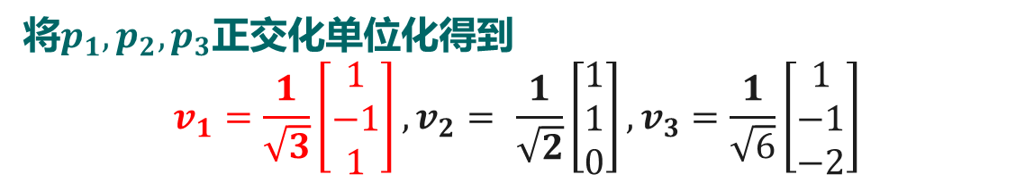
奇异值分解
例2 求$A=\left[\begin{matrix}1 & −1 & 1 \\ −2 & 2 & −2\end{matrix}\right]$的奇异值分解.
当$λ_{1}=15$时, 根据$\left(15E−A^{T}A\right)x=0$得到$p_{1}=\left[\begin{matrix}1 \\ −1 \\ 1\end{matrix}\right]$
当$λ_{2}=0$时, 根据$\left(0E−A^{T}A\right)x=0$得到$p_{2}=\left[\begin{matrix}1 \\ 1 \\ 0\end{matrix}\right],p_{3}=\left[\begin{matrix}1 \\ 0 \\ −1\end{matrix}\right]$
将$p_{1},p_{2},p_{3}$正交化单位化得到
$$v_{1}=\frac{1}{\sqrt{3}}\left[\begin{matrix}1 \\ −1 \\ 1\end{matrix}\right],v_{2}= \frac{1}{\sqrt{2}}\left[\begin{matrix}1 \\ 1 \\ 0\end{matrix}\right],v_{3}=\frac{1}{\sqrt{6}}\left[\begin{matrix}1 \\ −1 \\ −2\end{matrix}\right]$$
令$V=\left[\begin{matrix}1/{\sqrt{3}} & 1/{\sqrt{2}} & 1/{\sqrt{6}} \\ −1/{\sqrt{3}} & 1/{\sqrt{2}} & {−1}/{\sqrt{6}} \\ 1/{\sqrt{3}} & 0 & −2/{\sqrt{6}}\end{matrix}\right]$.

Slide 16
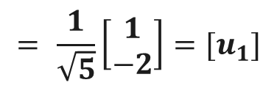
奇异值分解
例2 求$A=\left[\begin{matrix}1 & −1 & 1 \\ −2 & 2 & −2\end{matrix}\right]$的奇异值分解.
取$U_{1}=AV_{1}D^{−1}=\frac{1}{\sqrt{3}}\left[\begin{matrix}1 & −1 & 1 \\ −2 & 2 & −2\end{matrix}\right]\left[\begin{matrix}1 \\ −1 \\ 1\end{matrix}\right] {\left[\sqrt{15}\right]}^{−1}$
$$= \frac{1}{\sqrt{5}}\left[\begin{matrix}1 \\ −2\end{matrix}\right]=[u_{1}]$$
解方程组$U_{1}^{T}x=0$, 得$\left[\begin{matrix}2 \\ 1\end{matrix}\right]$, 单位化得$u_{2}=\frac{1}{\sqrt{5}}\left[\begin{matrix}2 \\ 1\end{matrix}\right]$
令$U=\left[u_{1},u_{2}\right]=\frac{1}{\sqrt{5}}\left[\begin{matrix}−1 & 2 \\ 2 & 1\end{matrix}\right]$, 故$A=UΣV^{T}$.

Slide 17
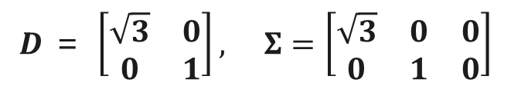
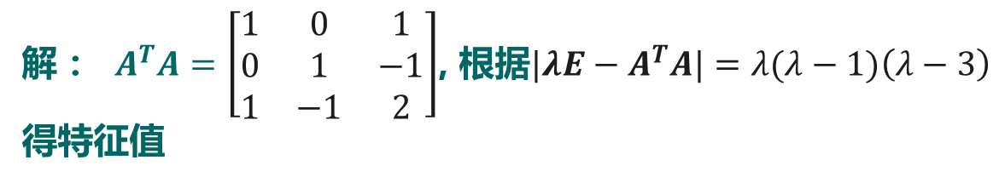
奇异值分解
例3 求$A=\left[\begin{matrix}1 & 0 & 1 \\ 0 & 1 & −1\end{matrix}\right]$的奇异值分解.
解： $A^{T}A=\left[\begin{matrix}1 & 0 & 1 \\ 0 & 1 & −1 \\ 1 & −1 & 2\end{matrix}\right]$, 根据$|λE−A^{T}A|=λ(λ−1)\left(λ−3\right)$得特征值
$$λ_{1}=3,λ_{2}=1,λ_{3}=0$$
正奇异值为$σ_{1}=\sqrt{3},σ_{2}=1$. 于是
$$D ＝ \left[\begin{matrix}\sqrt{3} & 0 \\ 0 & 1\end{matrix}\right], Σ=\left[\begin{matrix}\sqrt{3} & 0 & 0 \\ 0 & 1 & 0\end{matrix}\right]$$

Slide 18
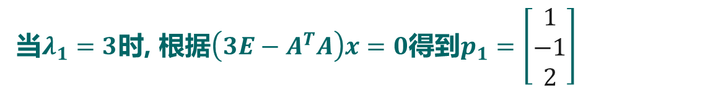
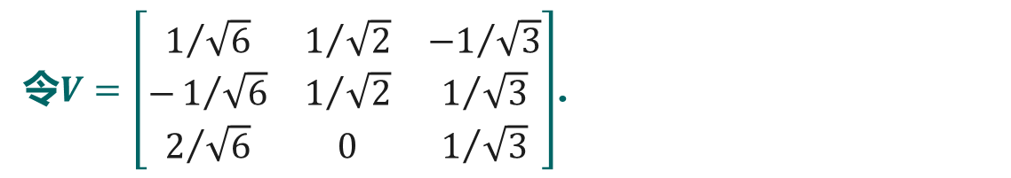

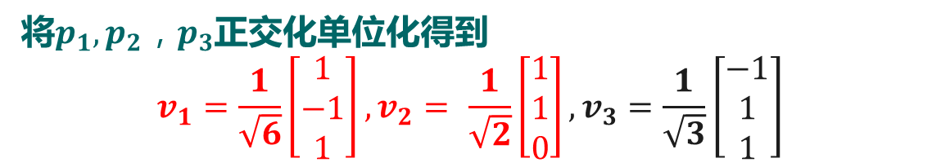
奇异值分解
例3 求$A=\left[\begin{matrix}1 & 0 & 1 \\ 0 & 1 & −1\end{matrix}\right]$的奇异值分解.
当$λ_{1}=3$时, 根据$\left(3E−A^{T}A\right)x=0$得到$p_{1}=\left[\begin{matrix}1 \\ −1 \\ 2\end{matrix}\right]$
同理当$λ_{2}=1$时, 得到$p_{2}=\left[\begin{matrix}1 \\ 1 \\ 0\end{matrix}\right]$；当$λ_{3}=$0时, 得到$p_{3}=\left[\begin{matrix}−1 \\ 1 \\ 1\end{matrix}\right]$
将$p_{1},p_{2}{，p}_{3}$正交化单位化得到
$$v_{1}=\frac{1}{\sqrt{6}}\left[\begin{matrix}1 \\ −1 \\ 1\end{matrix}\right],v_{2}= \frac{1}{\sqrt{2}}\left[\begin{matrix}1 \\ 1 \\ 0\end{matrix}\right],v_{3}=\frac{1}{\sqrt{3}}\left[\begin{matrix}−1 \\ 1 \\ 1\end{matrix}\right]$$
令$V=\left[\begin{matrix}1/{\sqrt{6}} & 1/{\sqrt{2}} & {−1}/{\sqrt{3}} \\ −1/{\sqrt{6}} & 1/{\sqrt{2}} & 1/{\sqrt{3}} \\ 2/{\sqrt{6}} & 0 & 1/{\sqrt{3}}\end{matrix}\right]$.

Slide 19
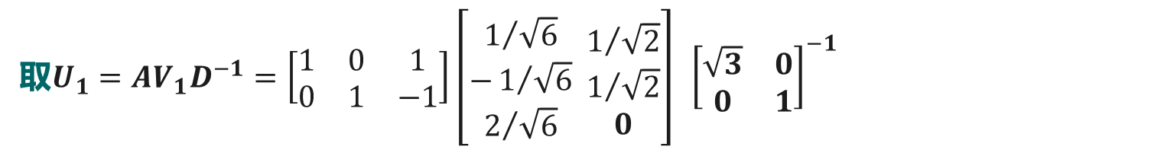
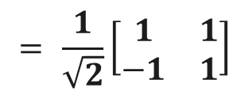
奇异值分解
例3 求$A=\left[\begin{matrix}1 & 0 & 1 \\ 0 & 1 & −1\end{matrix}\right]$的奇异值分解.
取$U_{1}=AV_{1}D^{−1}=\left[\begin{matrix}1 & 0 & 1 \\ 0 & 1 & −1\end{matrix}\right]\left[\begin{matrix}1/{\sqrt{6}} \\ −1/{\sqrt{6}} \\ 2/{\sqrt{6}}\end{matrix} \begin{matrix}1/{\sqrt{2}} \\ 1/{\sqrt{2}} \\ 0\end{matrix}\right] {\left[\begin{matrix}\sqrt{3} & 0 \\ 0 & 1\end{matrix}\right]}^{−1}$
$$= \frac{1}{\sqrt{2}}\left[\begin{matrix}1 & 1 \\ −1 & 1\end{matrix}\right]$$
令$U=U_{1}=\frac{1}{\sqrt{2}}\left[\begin{matrix}1 & 1 \\ −1 & 1\end{matrix}\right]$, 故$A=UΣV^{T}$.

